Slide 1

CS 533 INTRO TO DATA SCIENCE
Michael Ekstrand

Slide 2
TESTING HYPOTHESES

Slide 3

Learning Outcomes
Define null and alternative hypotheses
Carry out a T-test for a hypothesis
Bootstrap a p-value
Photo by Amplitude Magazin on Unsplash

Slide 4
Flippers
Do Gentoo penguins have longer flippers than Chinstrap penguins?
What we can do:
Measure difference in average flipper length
Compute probability we would see that big a difference if they didn’t have longer flippers
This is called a “p-value”.

Slide 5
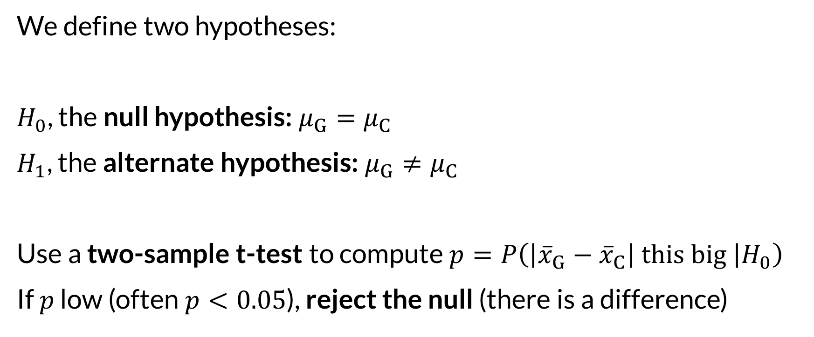
Hypotheses
We define two hypotheses:
$H_{0}$, the null hypothesis: $μ_{G}=μ_{C}$
$H_{1}$, the alternate hypothesis: $μ_{G}≠μ_{C}$
Use a two-sample t-test to compute $p=P\left(\left|{\overline{x}}_{G}−{\overline{x}}_{C}\right| this big | H_{0}\right)$
If $p$ low (often $p<0.05$), reject the null (there is a difference)

Slide 6
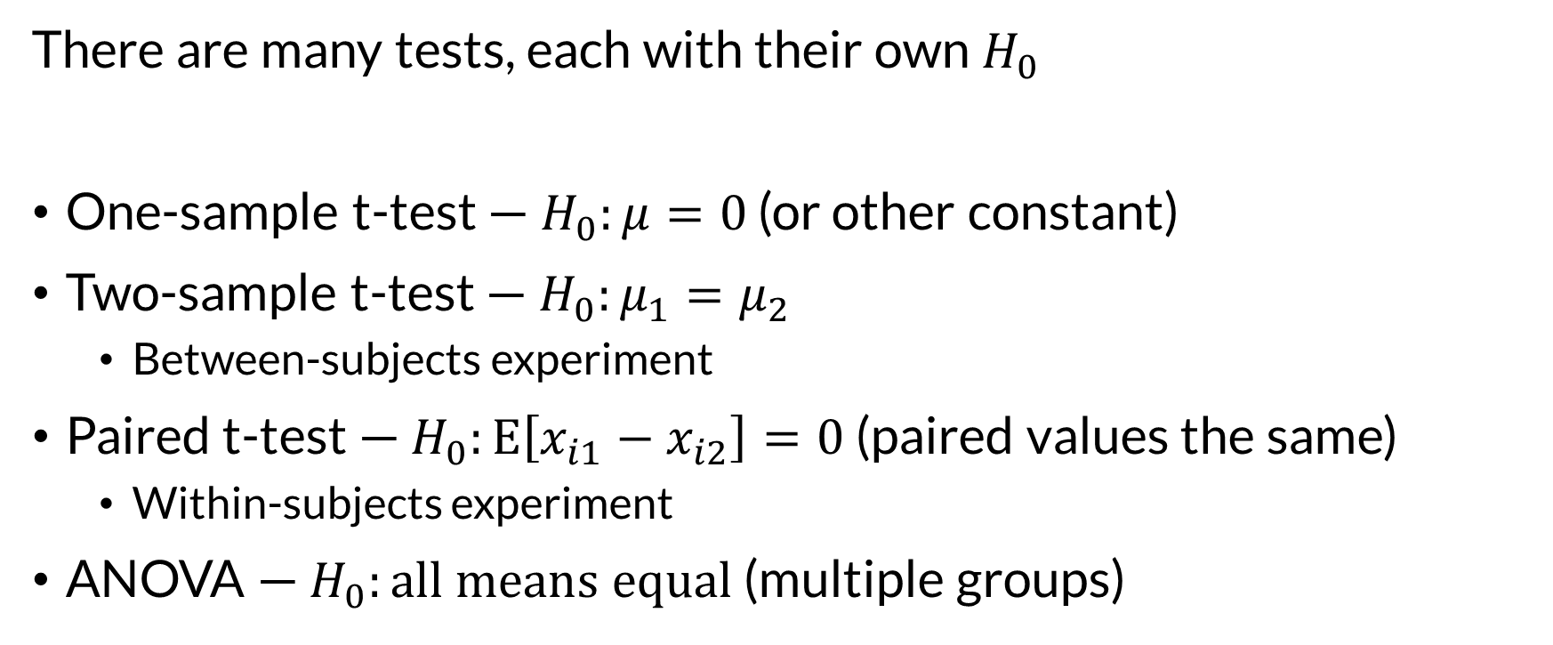
Tests
There are many tests, each with their own $H_{0}$
One-sample t-test — $H_{0}:μ=0$ (or other constant)
Two-sample t-test — $H_{0}:μ_{1}=μ_{2}$
Between-subjects experiment
Paired t-test — $H_{0}:E\left[x_{i1}−x_{i2}\right]=0$ (paired values the same)
Within-subjects experiment
ANOVA — $H_{0}:all means equal$ (multiple groups)

Slide 7
Assumptions
Each test makes assumptions.
These are often quite strong!
T-test: data are i.i.d. normal
Pretty robust to violations
ANOVA
Data are i.i.d. normal
NOT so robust

Slide 8
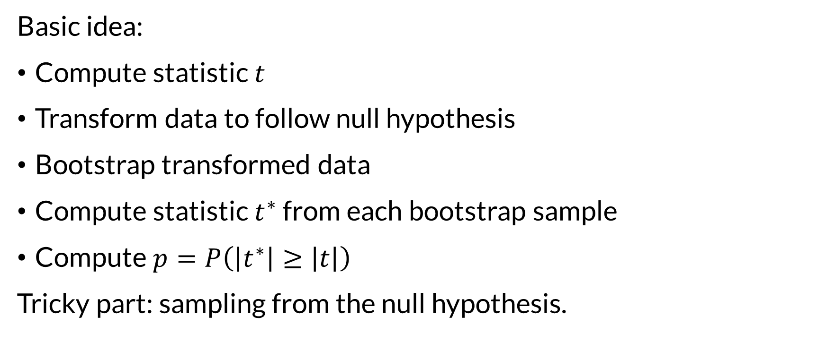
Bootstrapping the p-value
Basic idea:
Compute statistic $t$
Transform data to follow null hypothesis
Bootstrap transformed data
Compute statistic $t^{∗}$ from each bootstrap sample
Compute $p=P\left(\left|t^{∗}\right|≥\left|t\right|\right)$
Tricky part: sampling from the null hypothesis.

Slide 9
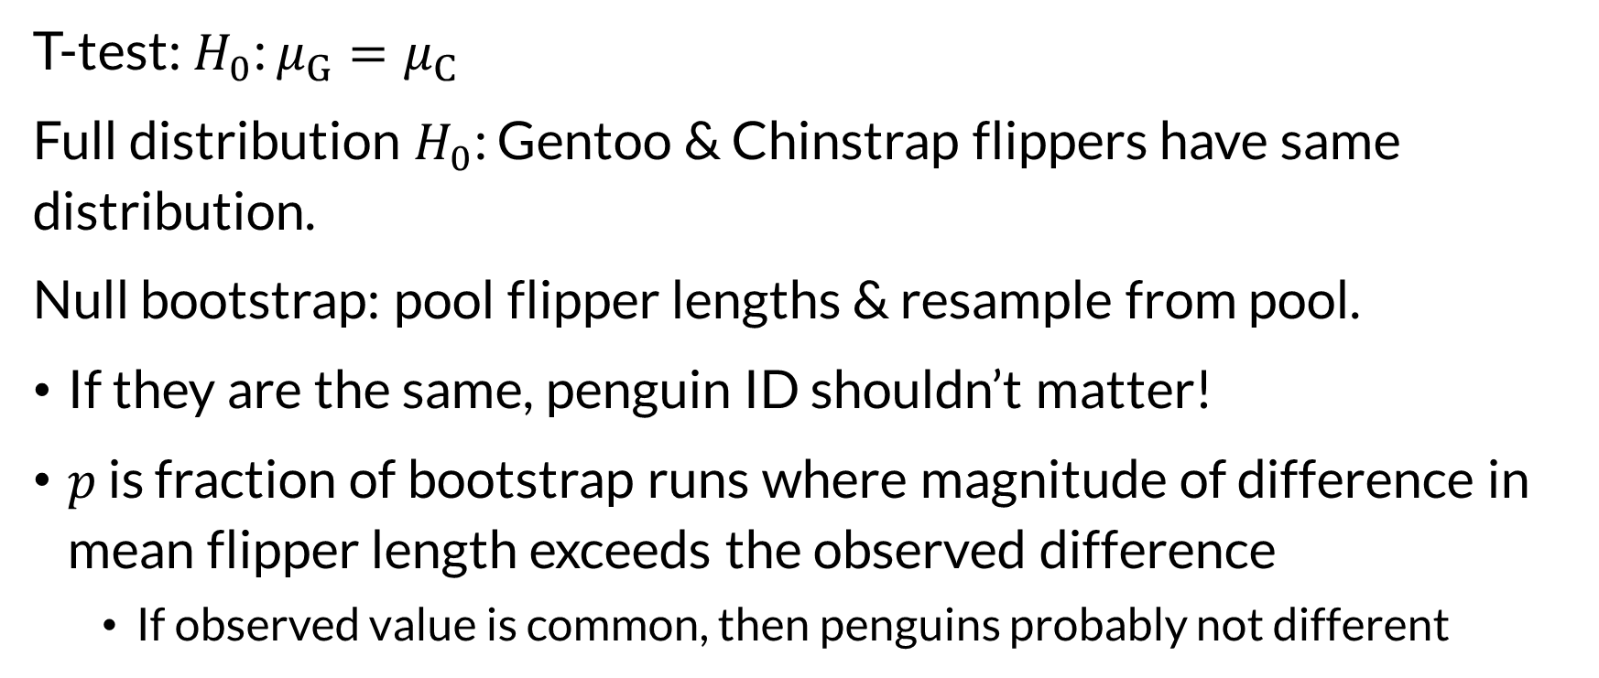
Flippers
T-test: $H_{0}$: $μ_{G}=μ_{C}$
Full distribution $H_{0}$: Gentoo & Chinstrap flippers have same distribution.
Null bootstrap: pool flipper lengths & resample from pool.
If they are the same, penguin ID shouldn’t matter!
$p$ is fraction of bootstrap runs where magnitude of difference in mean flipper length exceeds the observed difference
If observed value is common, then penguins probably not different

Slide 10
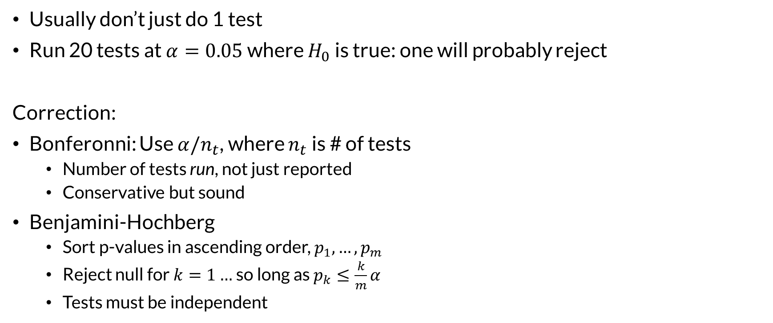

Multiple Comparisons
Usually don’t just do 1 test
Run 20 tests at $α=0.05$ where $H_{0}$ is true: one will probably reject
Correction:
Bonferonni: Use $α/n_{t}$, where $n_{t}$ is # of tests
Number of tests run, not just reported
Conservative but sound
Benjamini-Hochberg
Sort p-values in ascending order, $p_{1},…,p_{m}$
Reject null for $k=1…$ so long as $p_{k}≤\frac{k}{m}α$
Tests must be independent
What are the for?
If claiming discovery, must correct.
If one piece of evidence? Uncorrected $p$ is still evidence, corroborate.

Slide 11
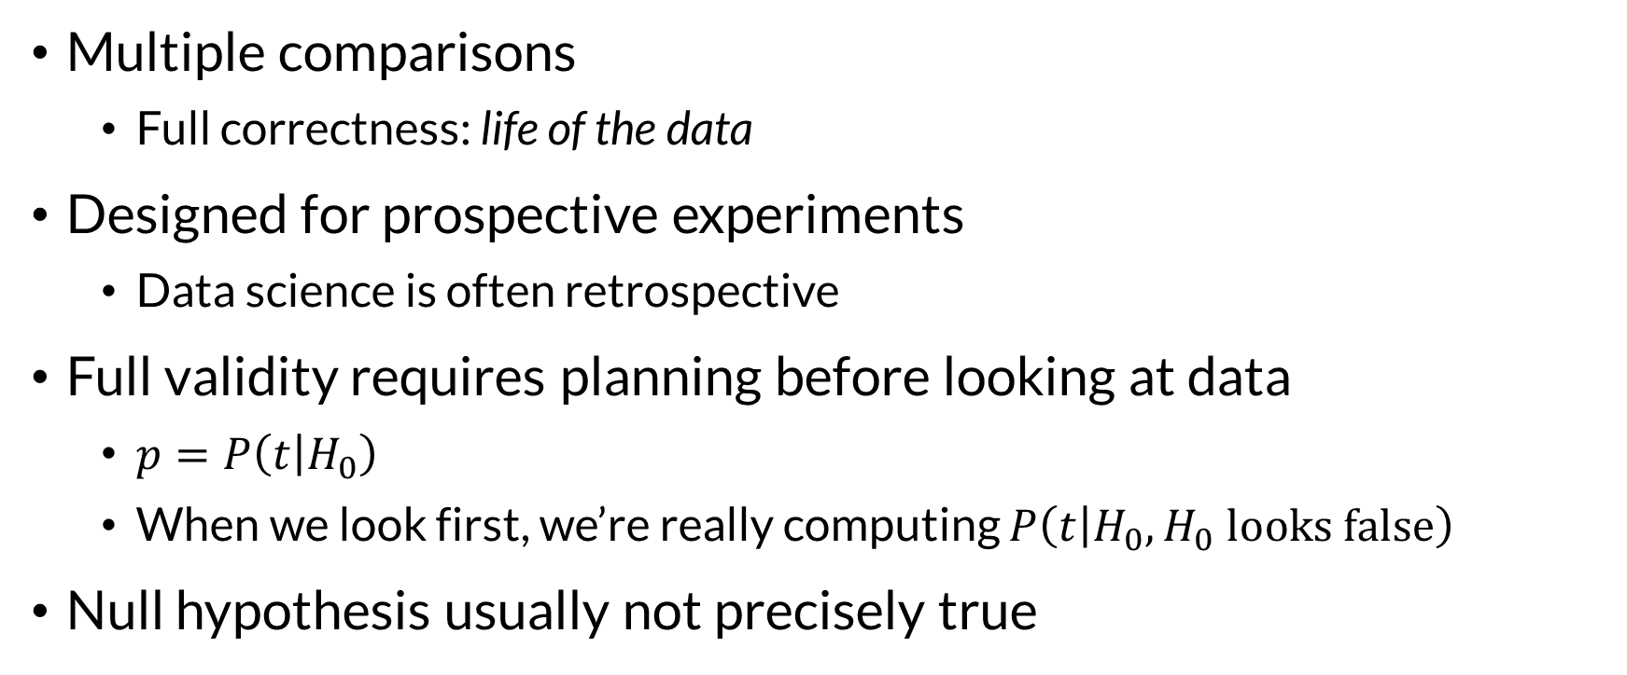
Pitfalls to p-values
Multiple comparisons
Full correctness: life of the data
Designed for prospective experiments
Data science is often retrospective
Full validity requires planning before looking at data
$p=P\left(t | H_{0}\right)$
When we look first, we’re really computing $P\left(t | H_{0},H_{0} looks false\right)$
Null hypothesis usually not precisely true

